Slide 1
IBM SKILLS BUILD DATA ANALYTICS

Slide 2
Name : Bijivemula Sumanth Kumar Reddy Email : bijivemulasumanthkumarreddy@gmail.com GitHub Link : https://github.com/bijivemulasumanthkumarreddy/IBMSKILLSBUILD-PROJECT Colab Link: https://colab.research.google.com/drive/1DU7K6E9VfY0bbjkm9ffFg3MYf2mI-OfY?usp=sharing

Slide 3
AICTE ID : STU6440d4579075e1681970263
College Name :
Madanapalle Institute of Technology and Science
College State : Andhra Pradesh
Internship Domain : Data Analytics
Internship Start date : 12-06-2023
Internship End date : 24-07-2023
Contact:+91 7093751187

Slide 4
PROJECT TOPIC
Analyzing the data for understanding the trends and patterns associated with profits and sales of superstore with the help of data visualization.
The trends and patterns desired will give insight and insights will lead to recommendations help in business to strategies for growth.

Slide 5
Analysis of superstore dataset
Introduction
Working with dataset
Visualization
Overall Analysis

Slide 6
Introduction
In this dataset we have many features like ship mode, Segment, country, city, state, postal code, region, category, sub-category, sales, quantity, discount, and the dependent variable is profit. The remaining are Independent variables.

Slide 7
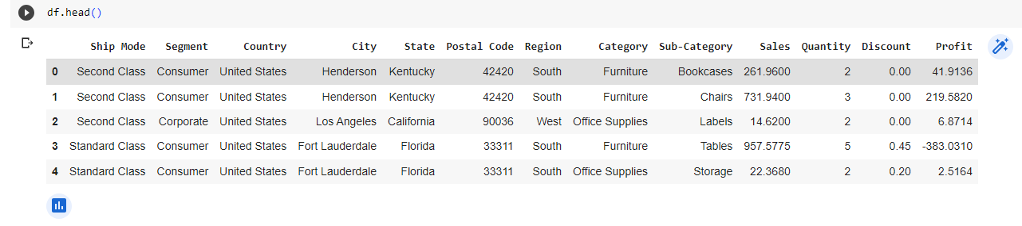
Working with superstore dataset

Slide 8
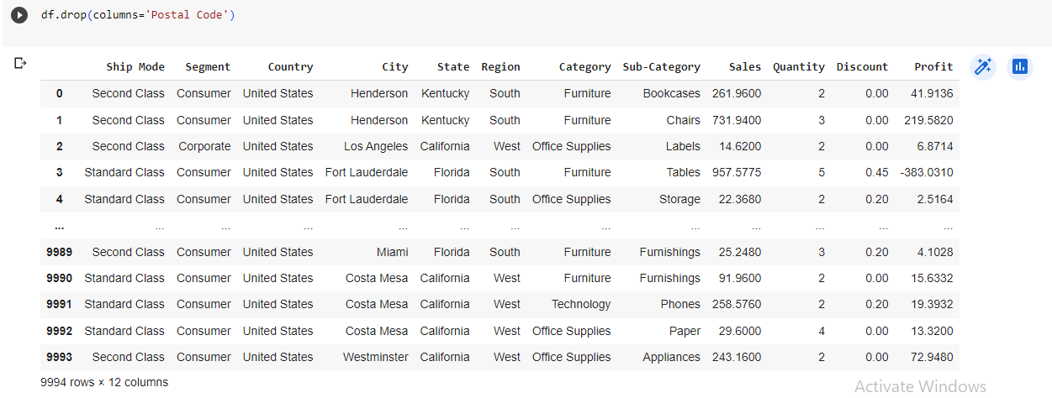
In this we don’t need postal code for analyzing the superstore dataset. So we will drop that column.

Slide 9
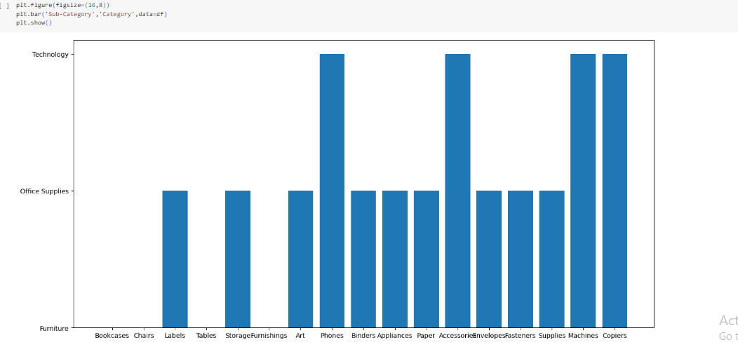
Visualizing the superstore dataset
Bar plot between category and sub-category
In this we can see the frequency of the item

Slide 10
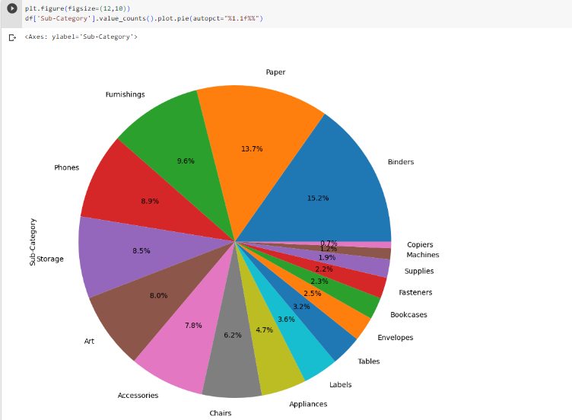
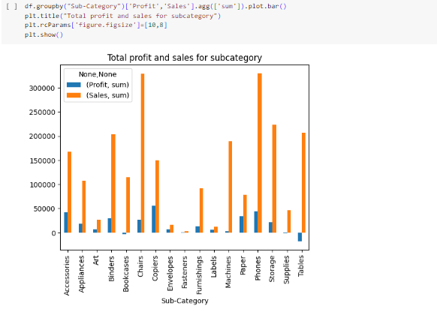

Slide 11
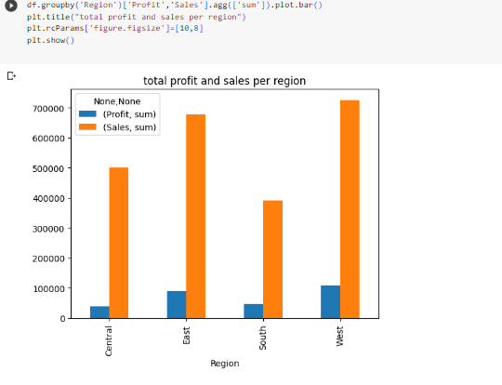
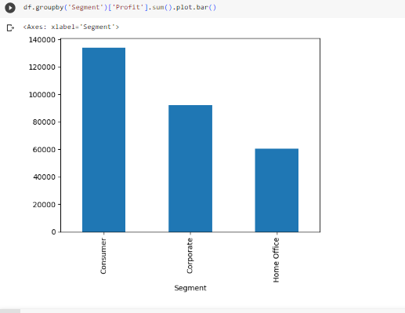

Slide 12
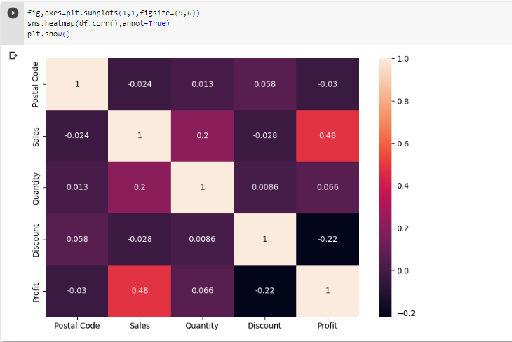
HEAT MAP FOR VISUALIZING DATASET

Slide 13
Conclusion
We have visualized and analyzed various use cases in the superstore dataset. We have got some insightful results about the Profits and Sales that can be used to improve future results.
This is what I understood from the superstore dataset and I analyzed the dataset accordingly.

